Slide 1
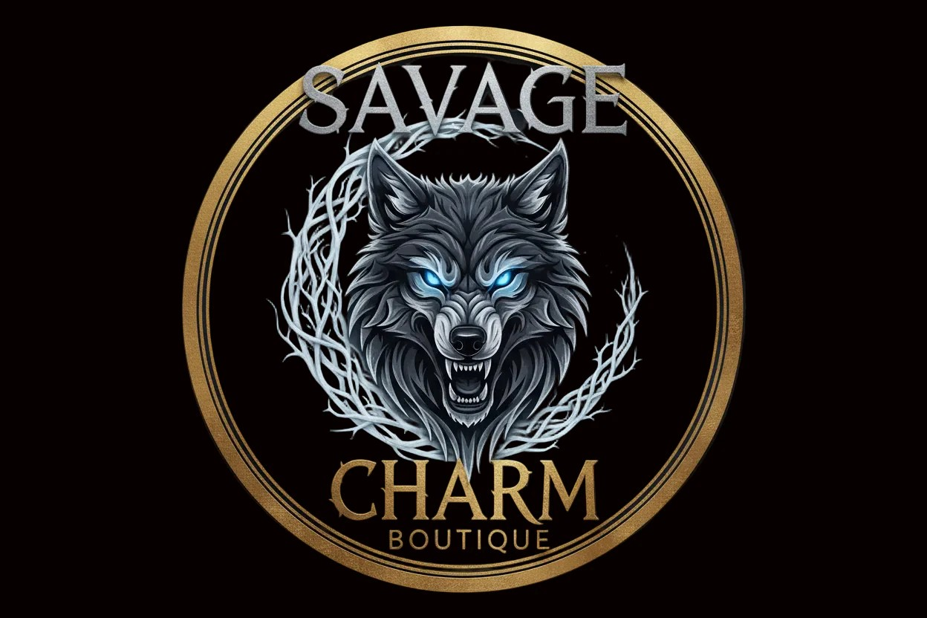
Savage Charm Boutique is a store for every woman who wants to free her inner self and have an untamed style. Savage charm refers to a magnetic, captivating appeal that comes from a woman's wild, or slightly rebellious nature.
Our signature products feature previously loved clothing from a variety of brand names:
1. Women's Sexy Sundress/Romper Sets
2. Women's Sultry Bikini Sets
3. Women's Playful Summer Outfit Sets
4. Women's Spicy Party Dress Sets

